Slide 1
Rocky planets
Gas giants
Internal Structure
Atmospheres (a tiny bit)
Notes:
Great Kurzgesagt video on the Solar System: https://www.youtube.com/watch?v=KsF_hdjWJjo

Slide 2
The Planets

Slide 3
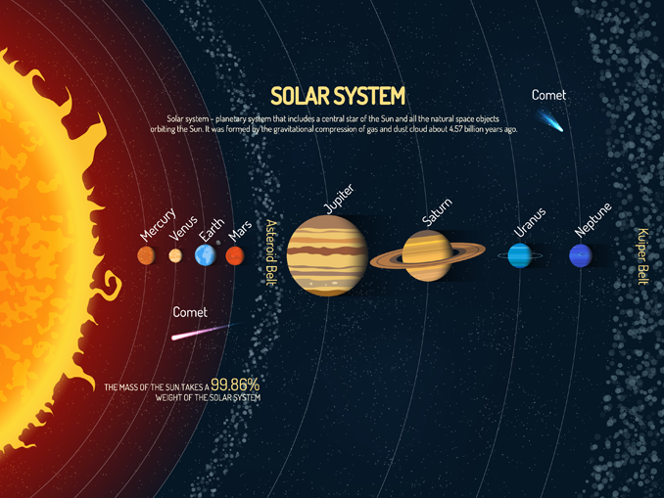
Not to Scale!
EARTHHOW
Notes:
Diagram of the SS by EarthHow: https://earthhow.com/solar-system-facts/
Oort cloud not shown!
Formed 4.571 billion years ago
Earth ~ 4.543 billion years

Slide 4
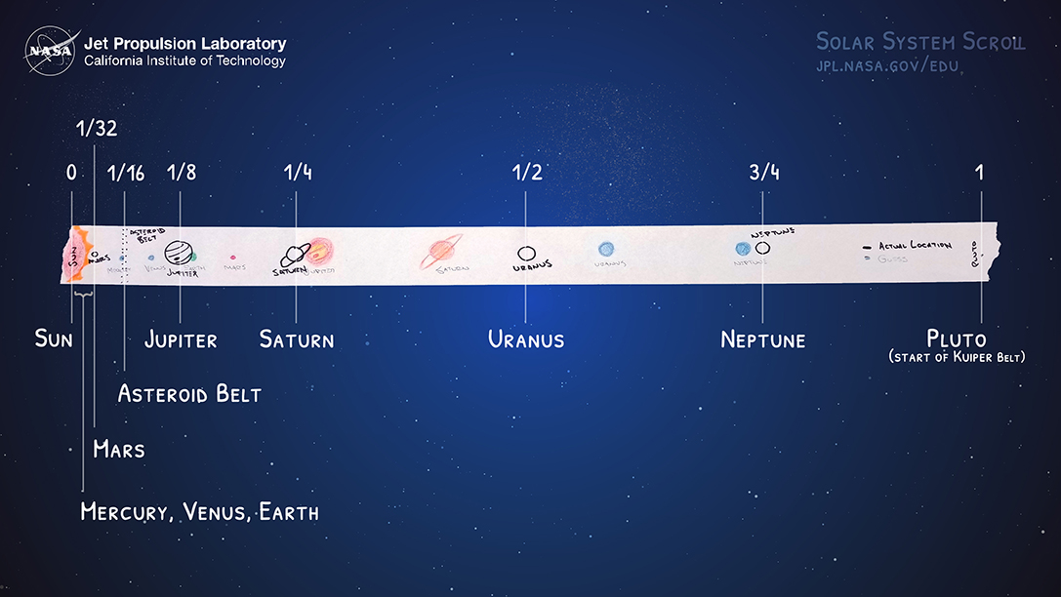
NASA/JPL
Notes:
Actual positions! – we did this practical last lesson

Slide 5
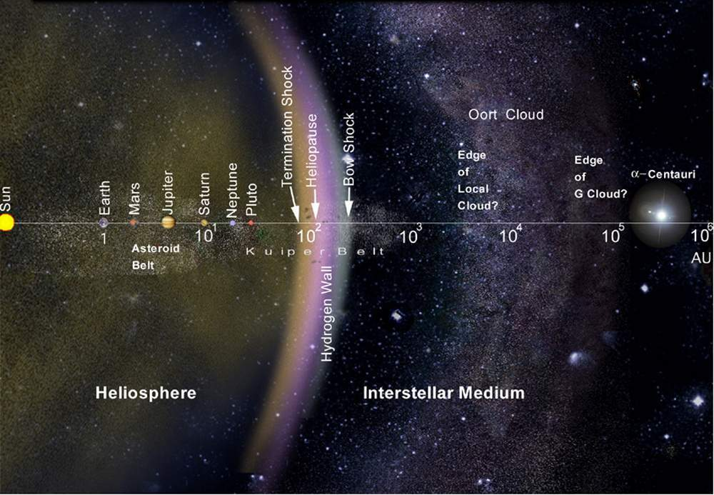
Solar System
1 AU = 1.495978707×10¹¹ m
NASA
Notes:
Image from an article about Voyager: https://voyager.jpl.nasa.gov/mission/did-you-know/
The Oort cloud extends to 1/5 the distance to the nearest star!
Notice the log scale
Termination shock – particles slow to less than the speed of sound
Heliopause – pressure from outside is the same as from the solar wind
Theoretical wall of Hydrogen just after the heliopause
Little to no bow shock around our Sun.
Oort cloud marks edge of gravitational influence of the Sun. All of that is embedded in the Local Cloud next to the G cloud which contains alpha Centauri. Outside the Oort cloud is interstellar space.

Slide 6
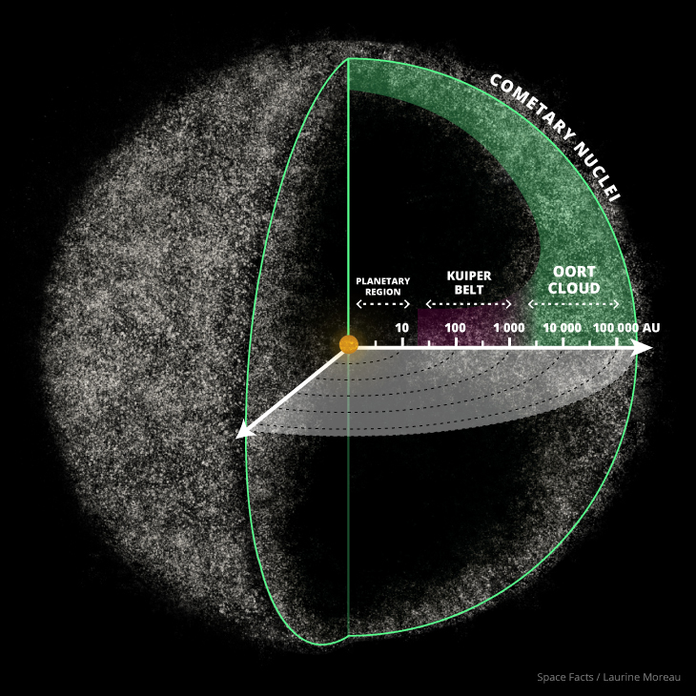
Solar System
Space Facts/Laurine Moreau
Notes:
Zoomed out to see the spherical shape of the cloud
Hard to visualise large numbers try making as many tallies on a piece of paper that you can in 60 s. How long would it take us to make a million tallies?
These are huge numbers!
Inner Oort cloud is disk shaped after Kuiper Belt and the outer cloud is spherical. Source of long period comets!

Slide 7
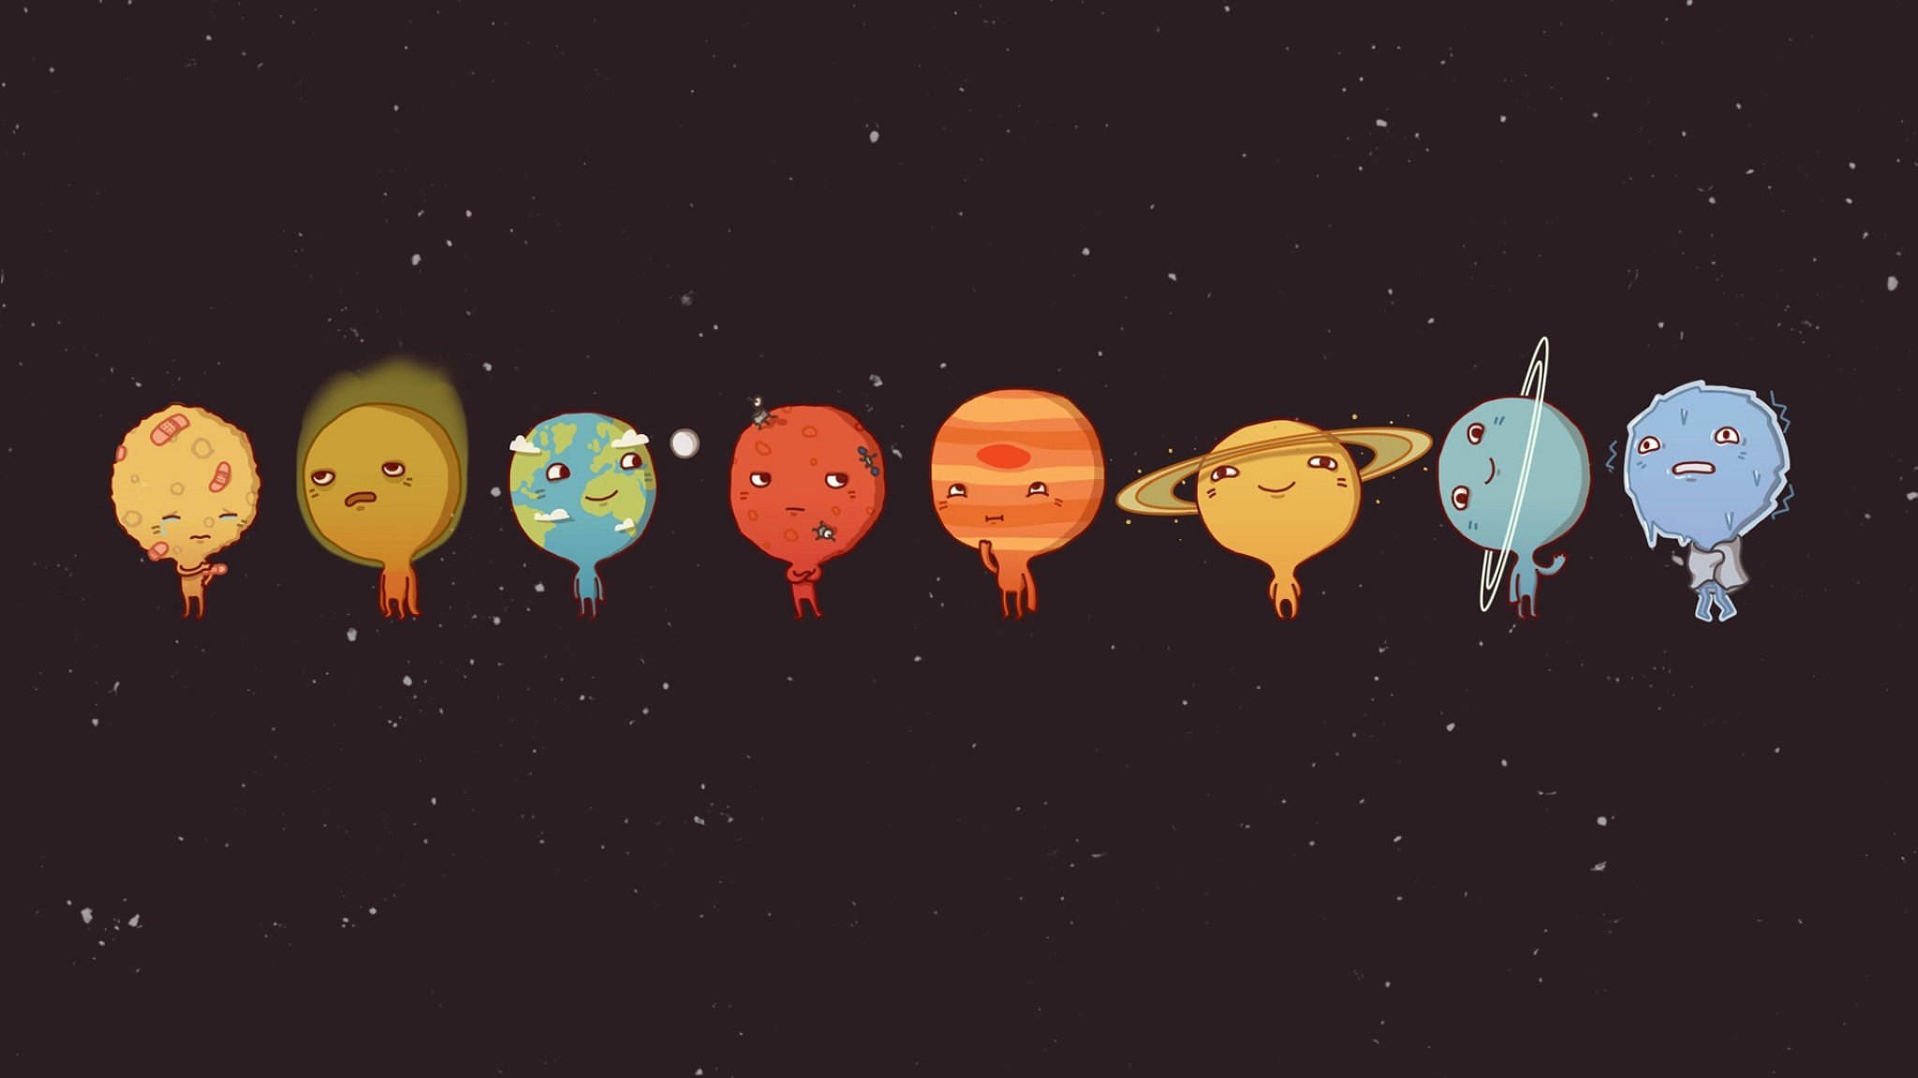
There are 8 planets!
Notes:
Image Author Unknown
Can you name the planets in order?

Slide 8
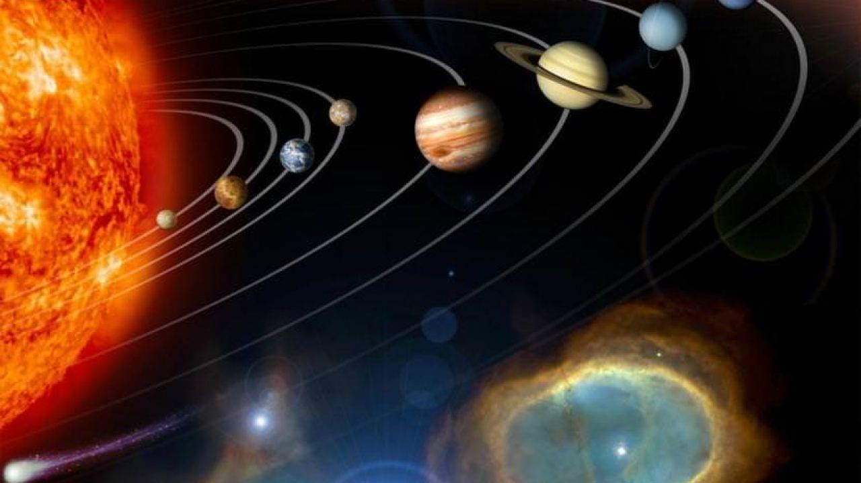
Mercury | My
Venus | Vicious
Earth | Earthworm
Mars | Might
Jupiter | Just
Saturn | Swallow
Uranus | Us
Neptune | Now
Linda Chisholm
Notes:
Easy way to remember the order.

Slide 9
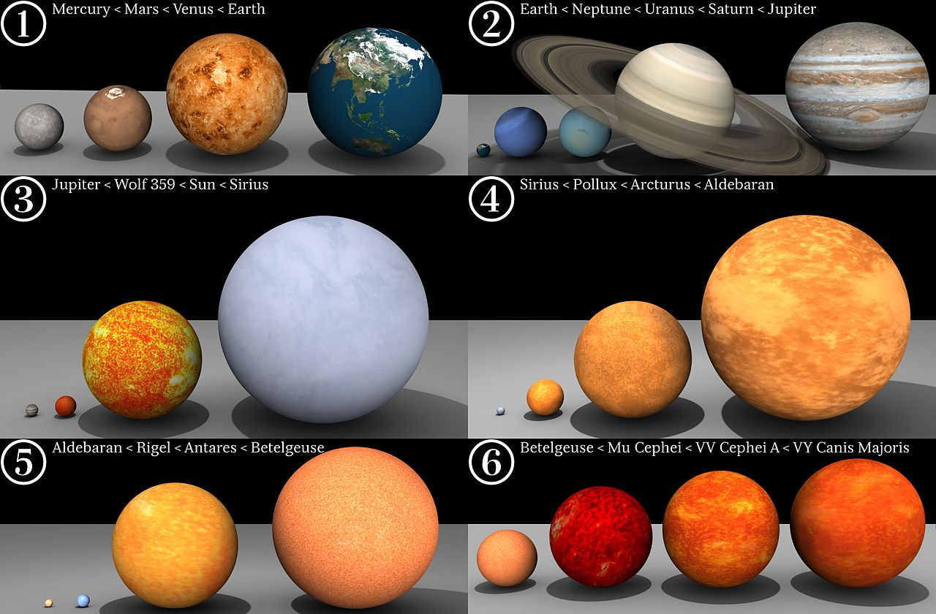
Dave Jarvis
Notes:
Planets to scale with stars for comparison.

Slide 10
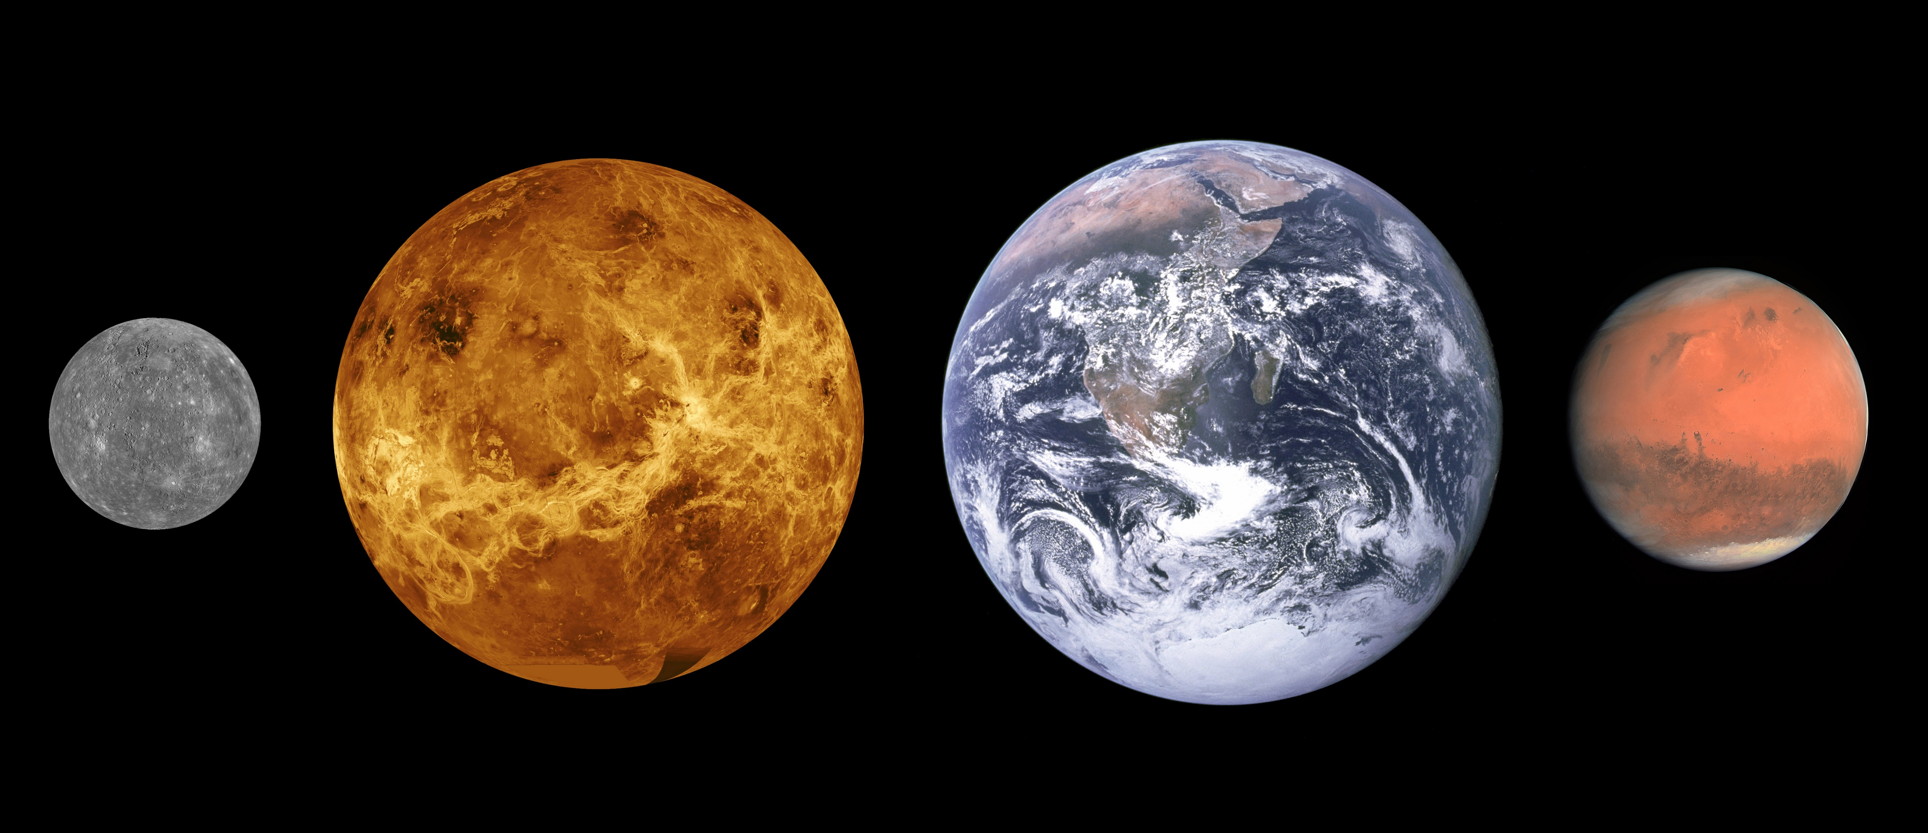
The Rocky Planets
Notes:
Mercury image: NASA/JHUAPL Venus image: NASA Earth image: NASA/Apollo 17 crew Mars image: ESA/MPS/UPD/LAM/IAA/RSSD/INTA/UPM/DASP/IDA
Scales are roughly correct, distances between them not so much.

Slide 11
MORE!!!!!!!!!!!!!!!!!!!!!!!!!!!!!!!!!!!!! Add my pictures etc (not the ones they do?) add AFL

Slide 12
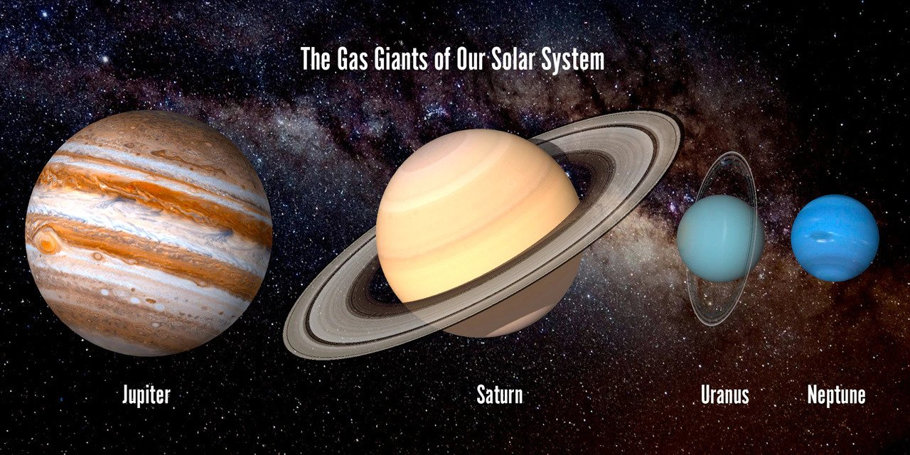
Notes:
Author Unknown

Slide 13
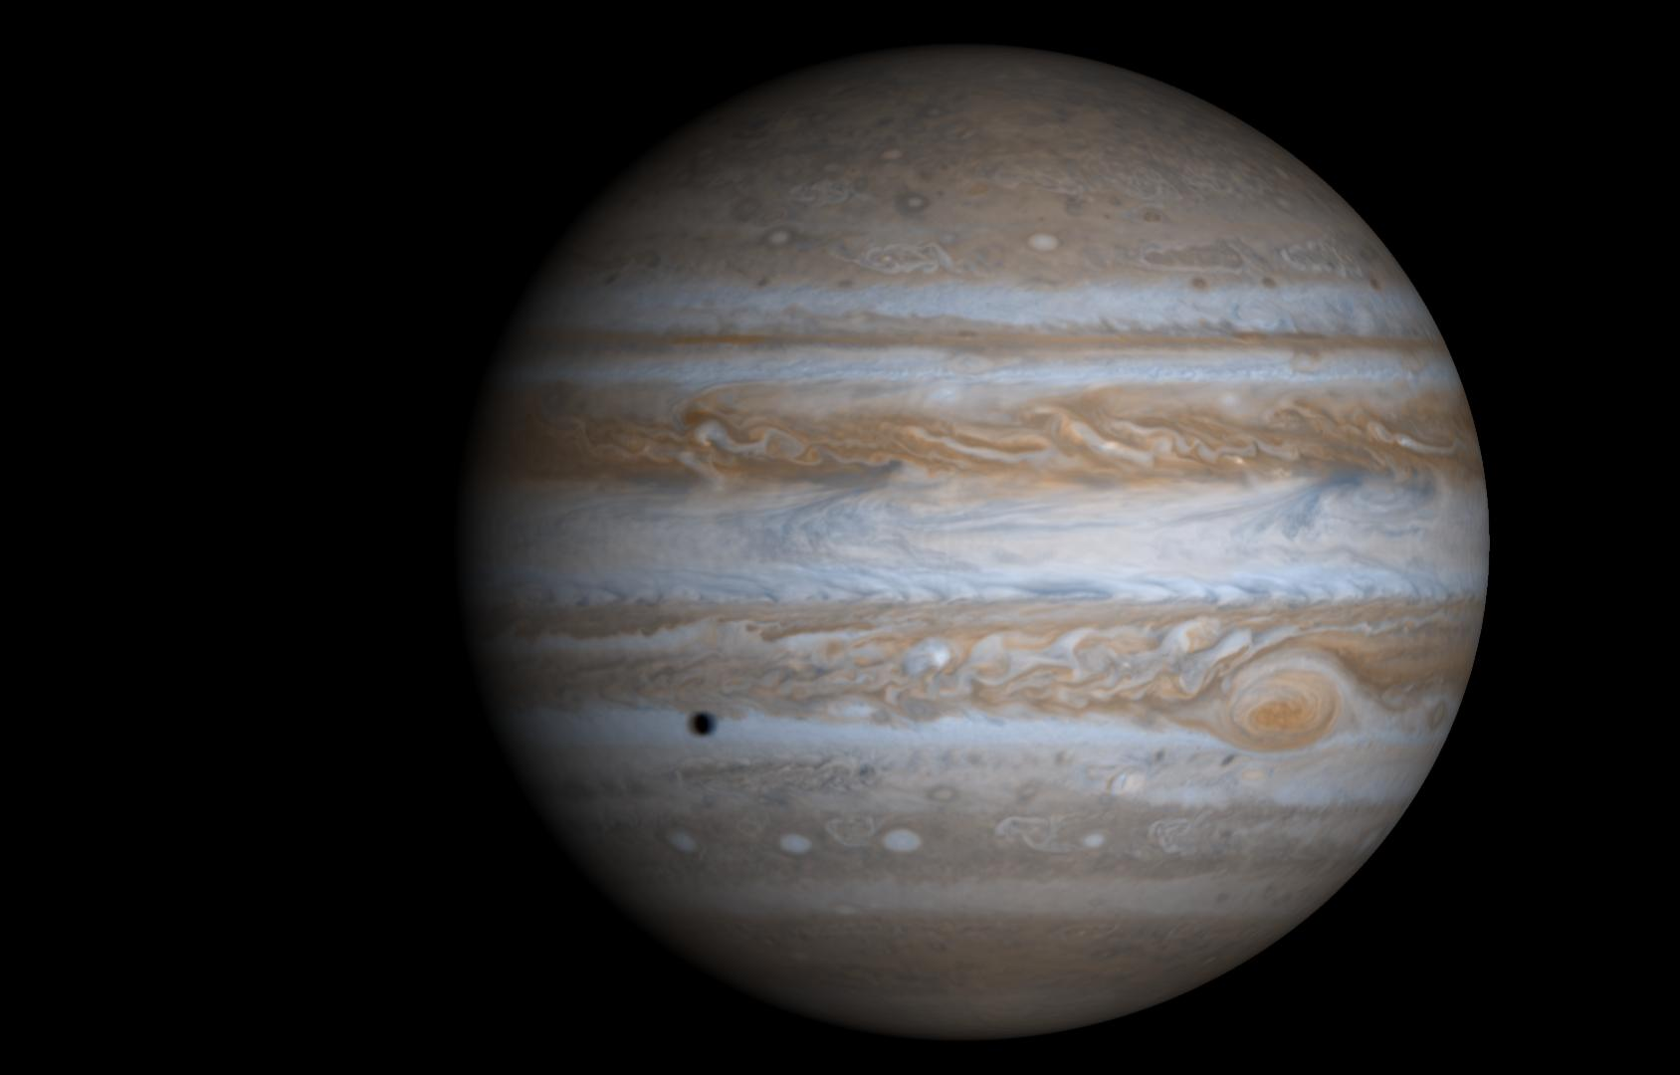
Jupiter
JPL/NASA
Notes:
Cassini Comp. with Europa shadow Molecular hydrogen 80-90% helium All four have rings RADIO JOVE you can hear the radio emission from Jupiter Any solid surface at high pressures deep within / red sulphur or phosphorus belts are convection cycles-Coriolis Metallic hydrogen 400 GPa behaves like a crystal lattice

Slide 14
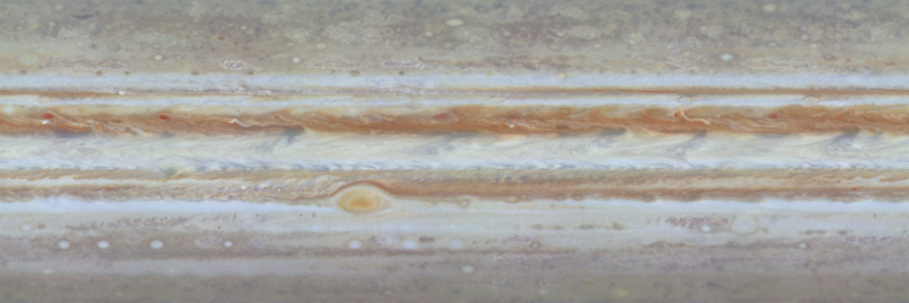
Jupiter
JPL/NASA
Notes:
1 year timelapse of 60 deg north to south. Shadows and satellites of Jupiter visible.

Slide 15
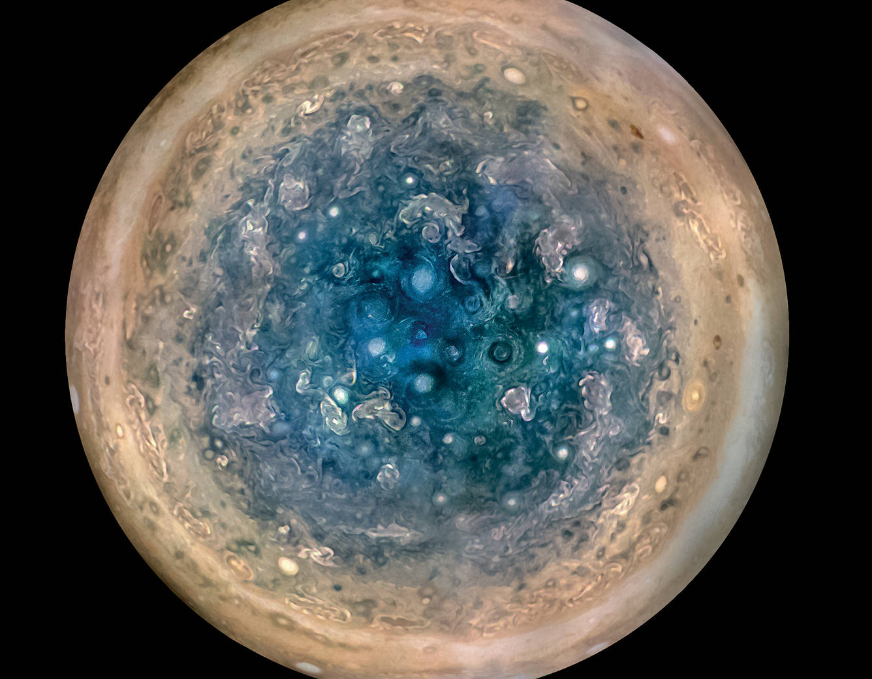
Jupiter
NASA/JPL-Caltech/SwRI/MSSS/
Betsy Asher Hall/Gervasio Robles
Notes:
Juno Orbiter image of South pole’s cyclones up to 1000 KM in diameter (~top Scotland John O’groats to Brighton) Enhanced Colour

Slide 16
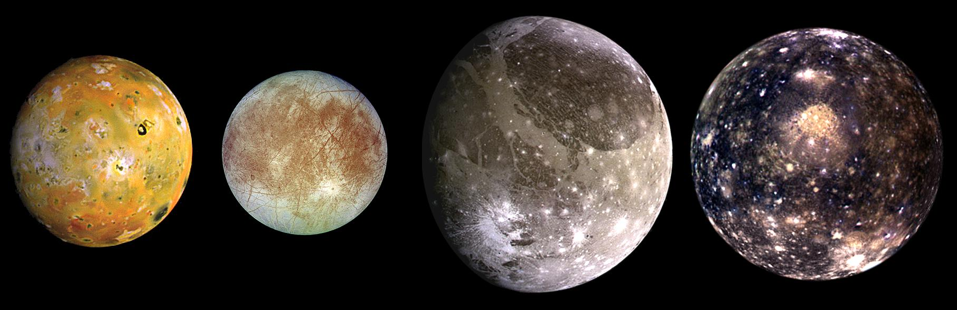
Jupiter’s Moons
JPL/NASA
Notes:
Io Galileo Europa Ganymede – Bigger than any dwarf planet Callisto

Slide 17
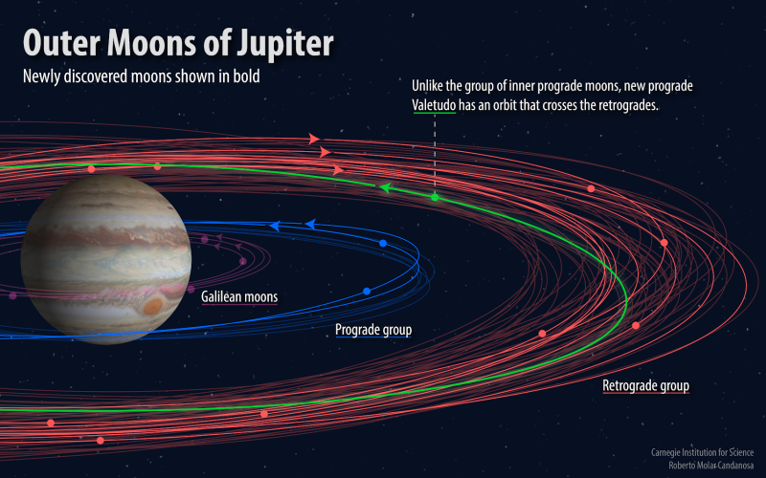
Jupiter’s Moons
JPL/NASA
Notes:
79 total 11 with DECAM (Dark Energy Camera from the DES survey) https://carnegiescience.edu/news/dozen-new-moons-jupiter-discovered-including-one-%E2%80%9Coddball%E2%80%9D

Slide 18
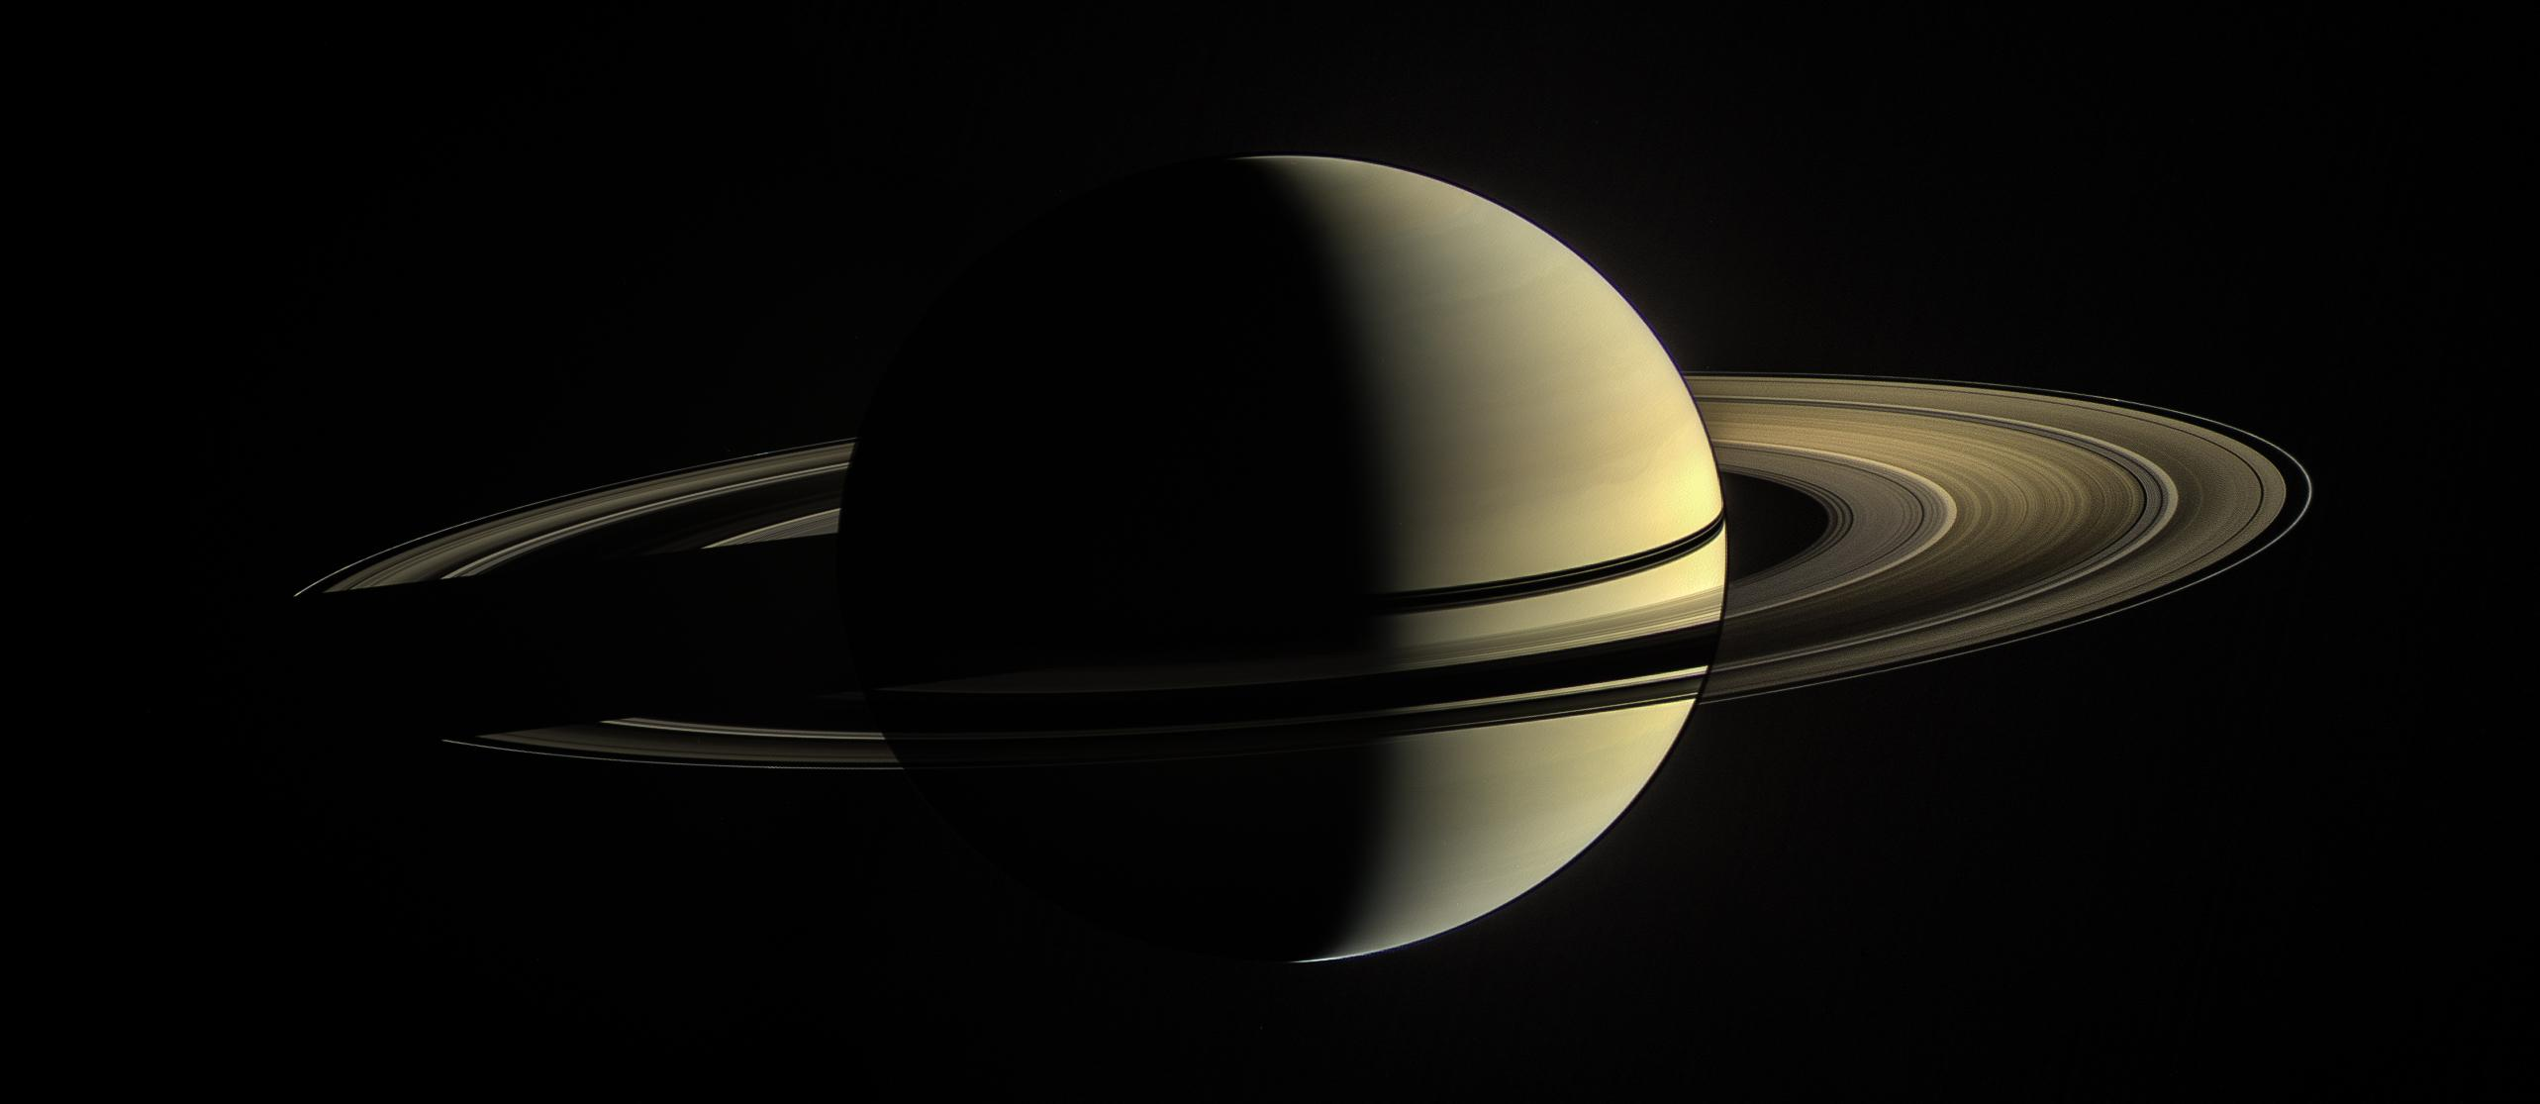
Saturn
JPL/NASA
Notes:
Cassini Comp. with Europa shadow

Slide 19
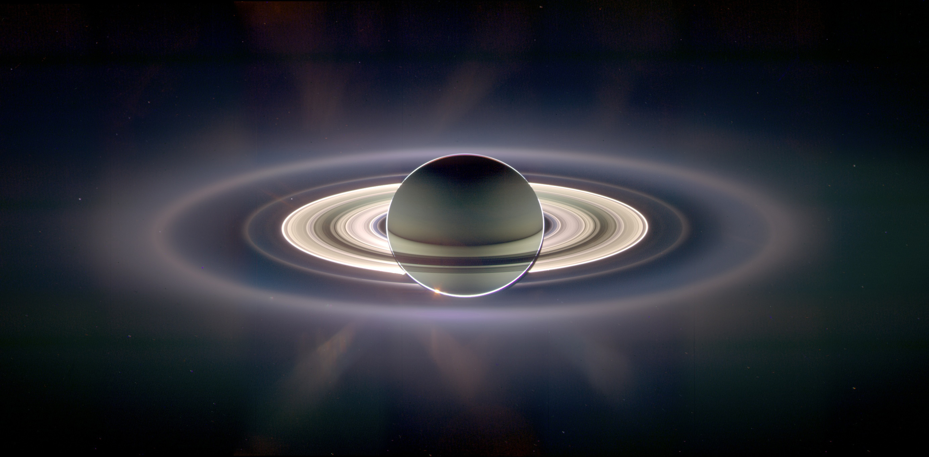
Saturn
JPL/NASA
Notes:
Cassini Comp. enhanced colour to reveal new rings and differences in composition.

Slide 20
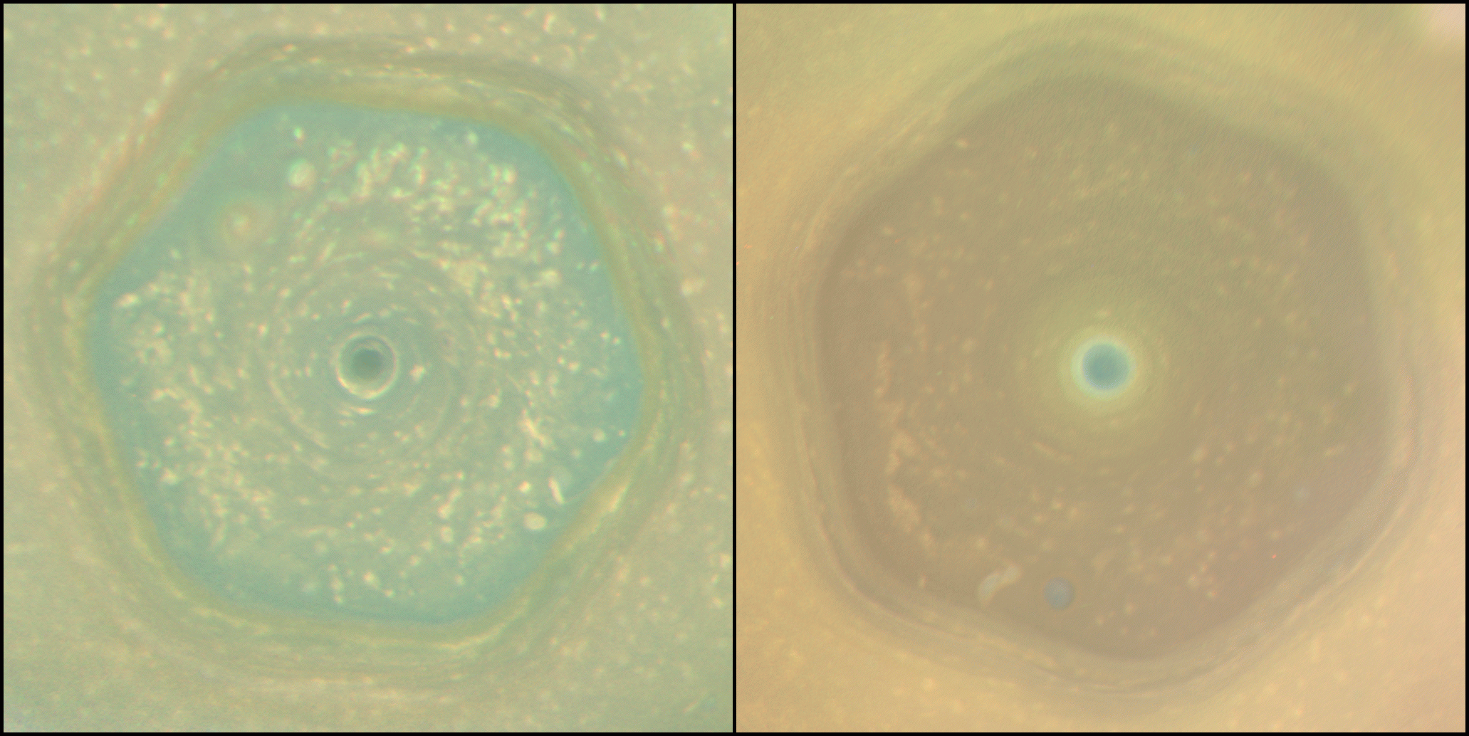
JPL/NASA
Notes:
Have form from early 2010s to 2017 due to change in tilt more UV exposure create red haze organic chemicals

Slide 21
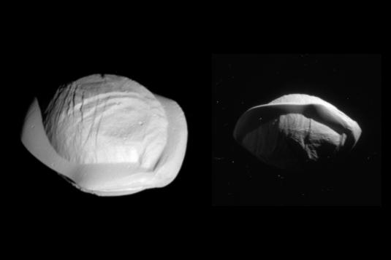
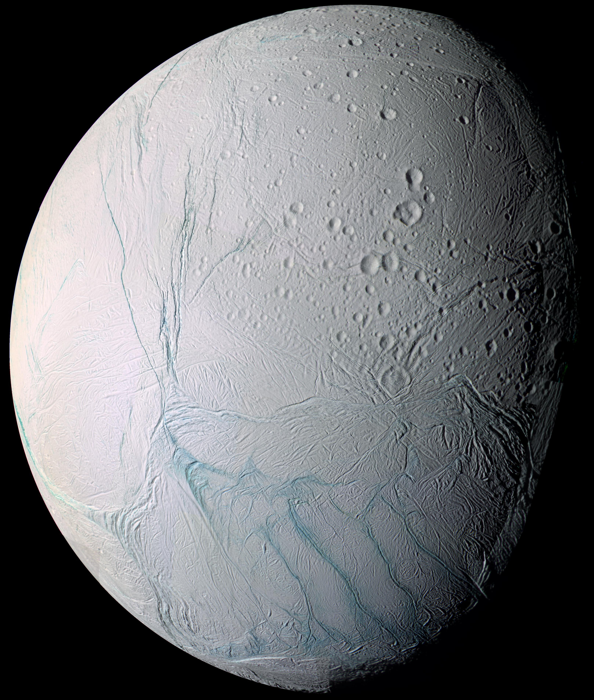
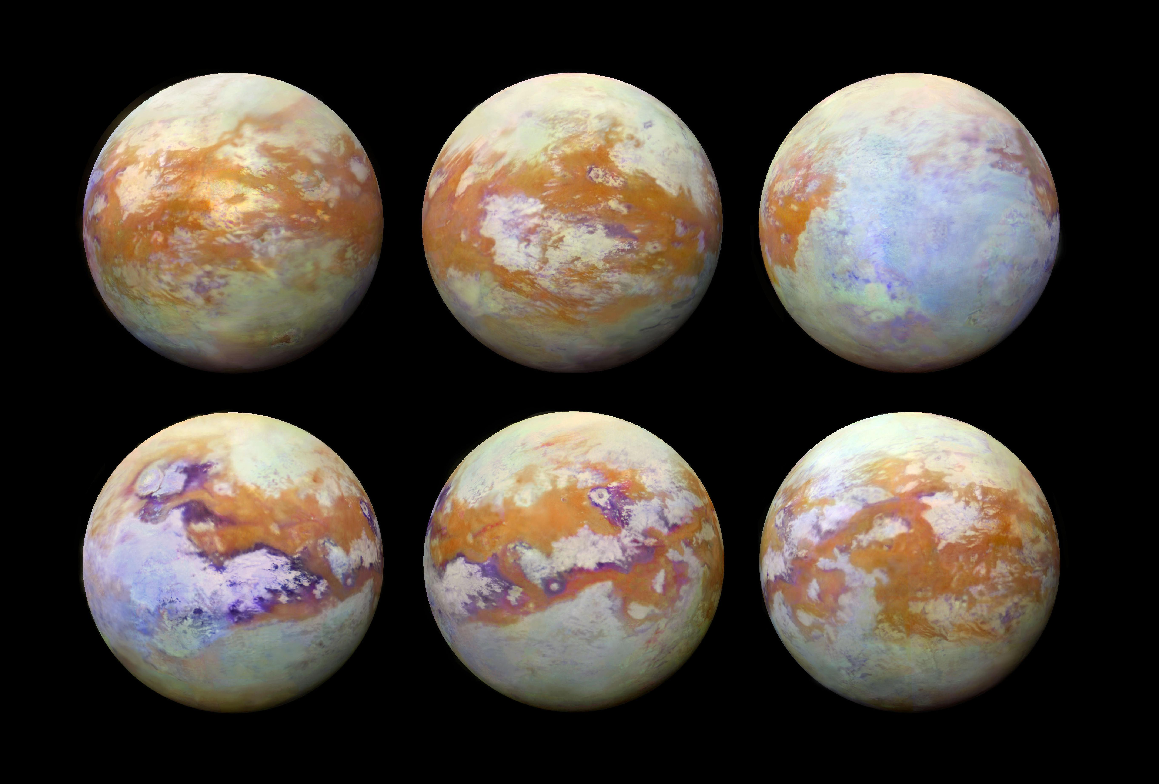
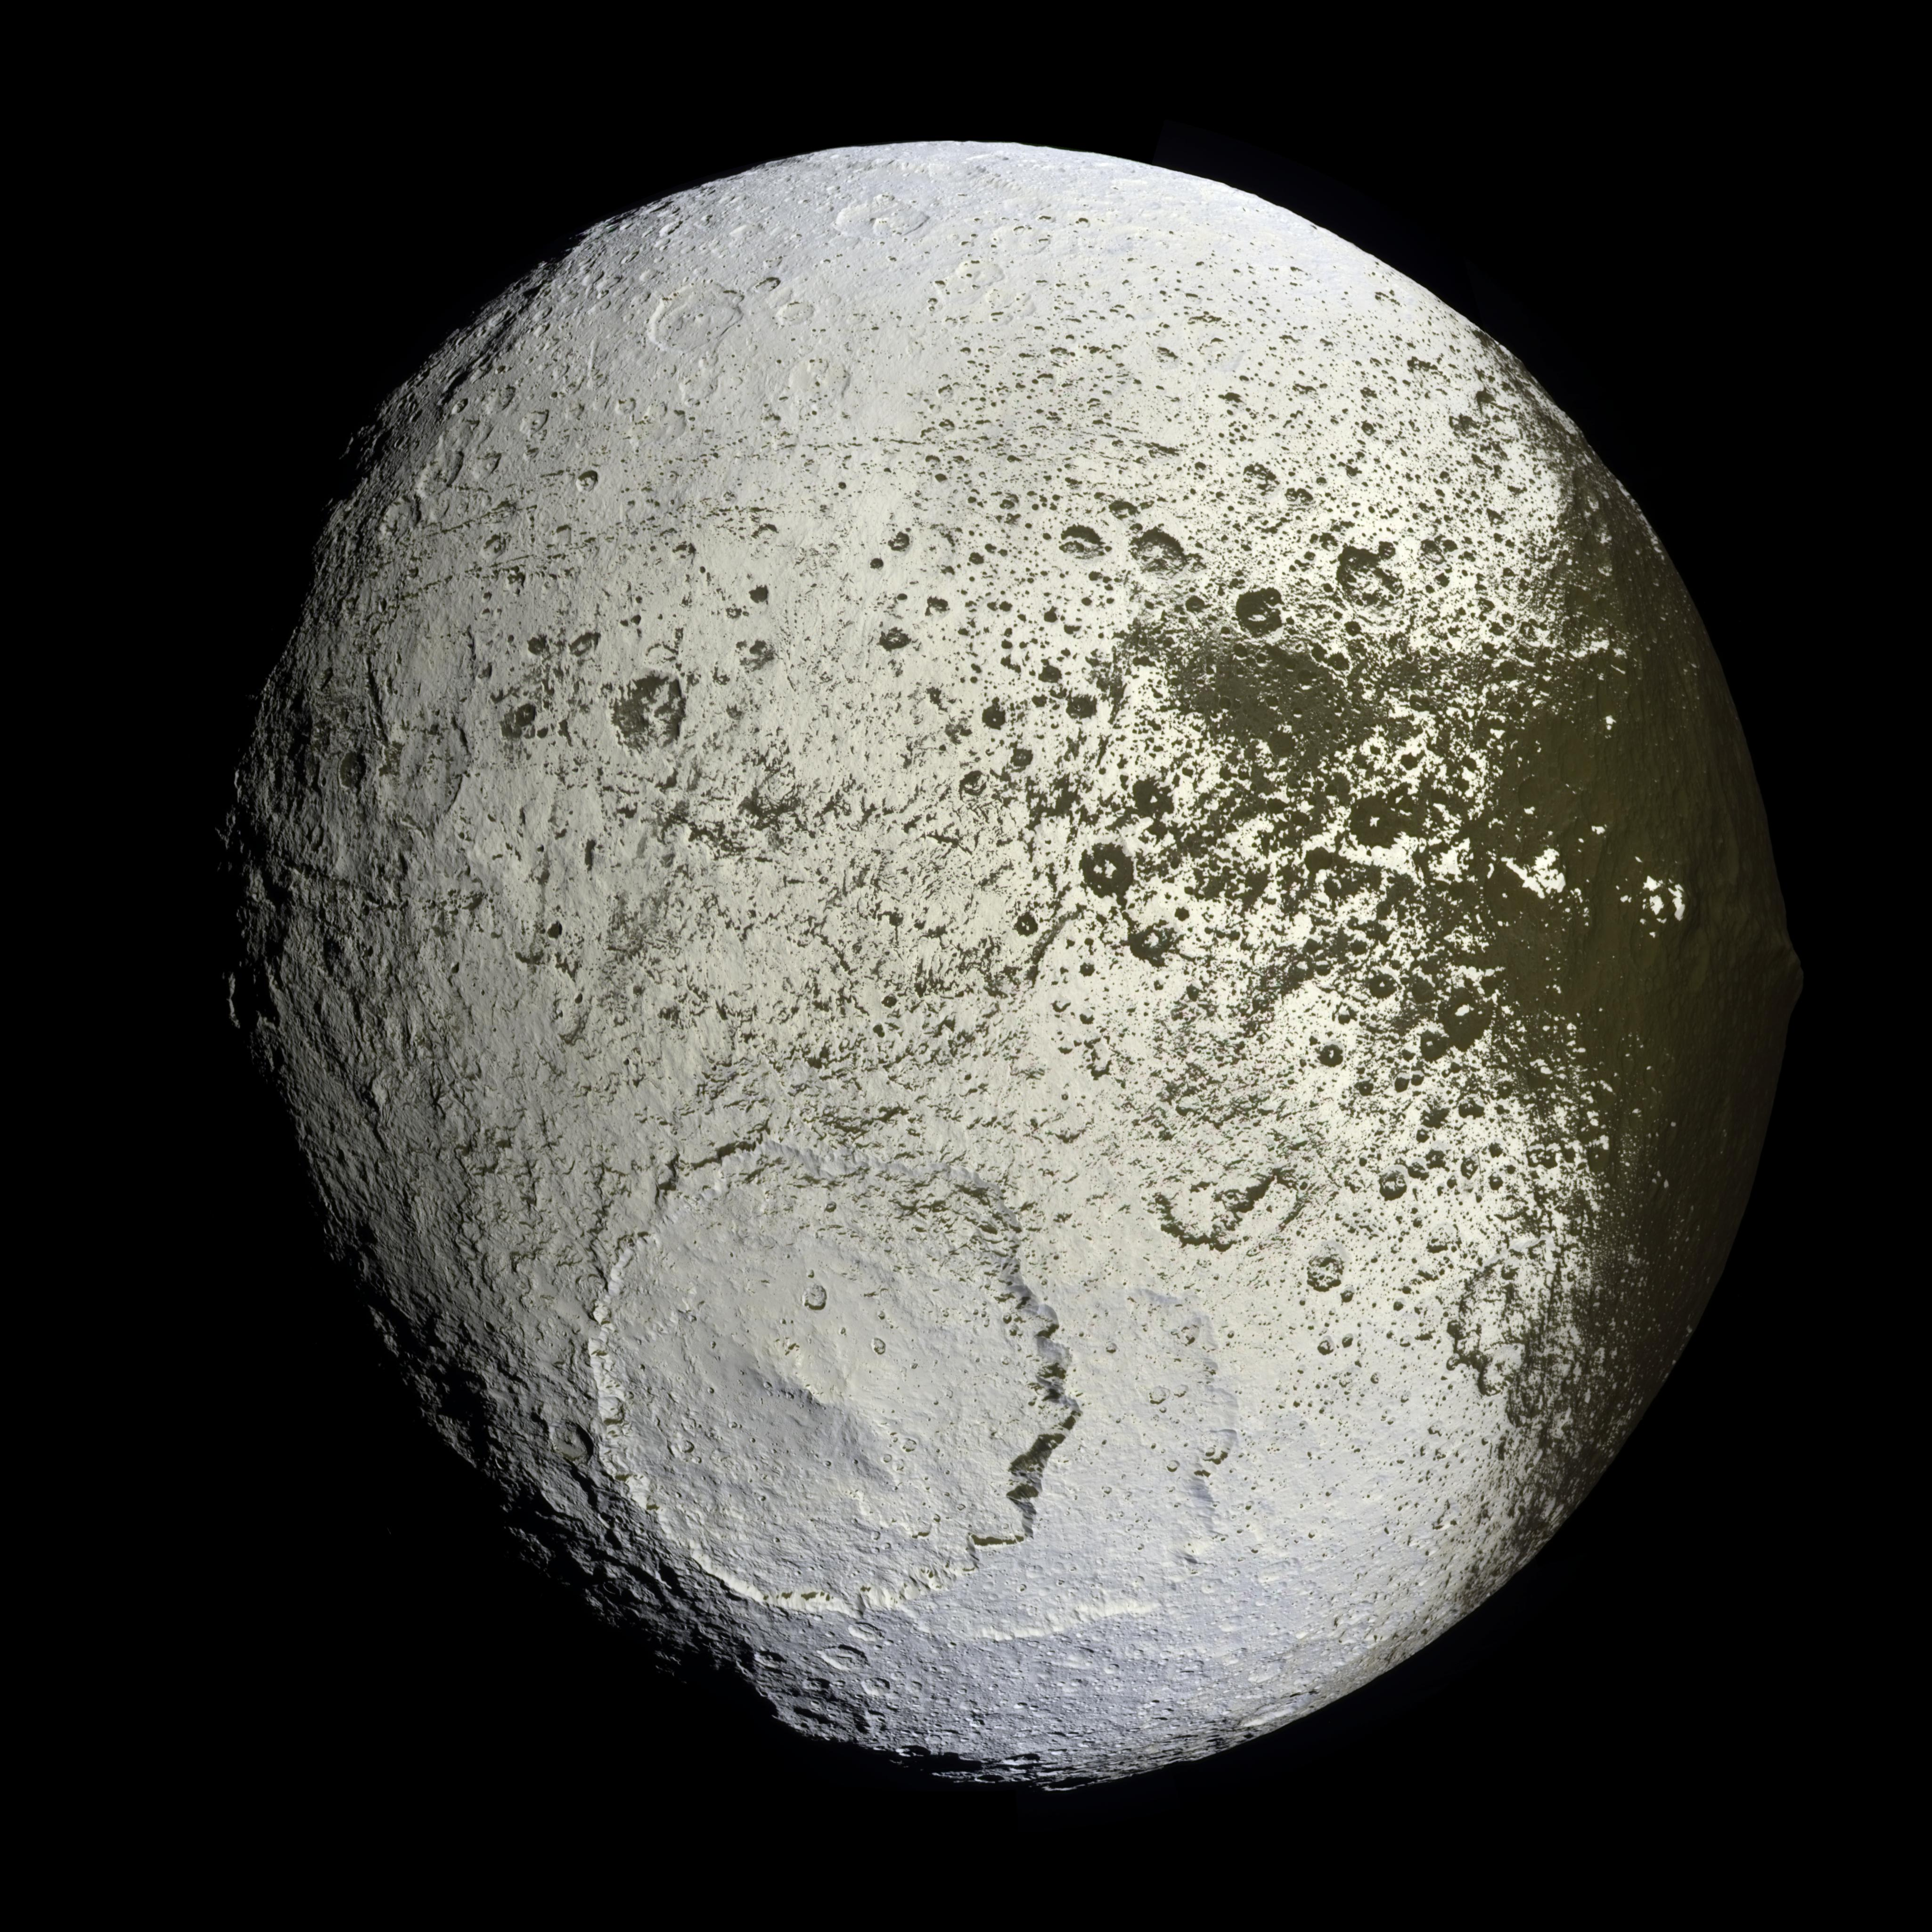
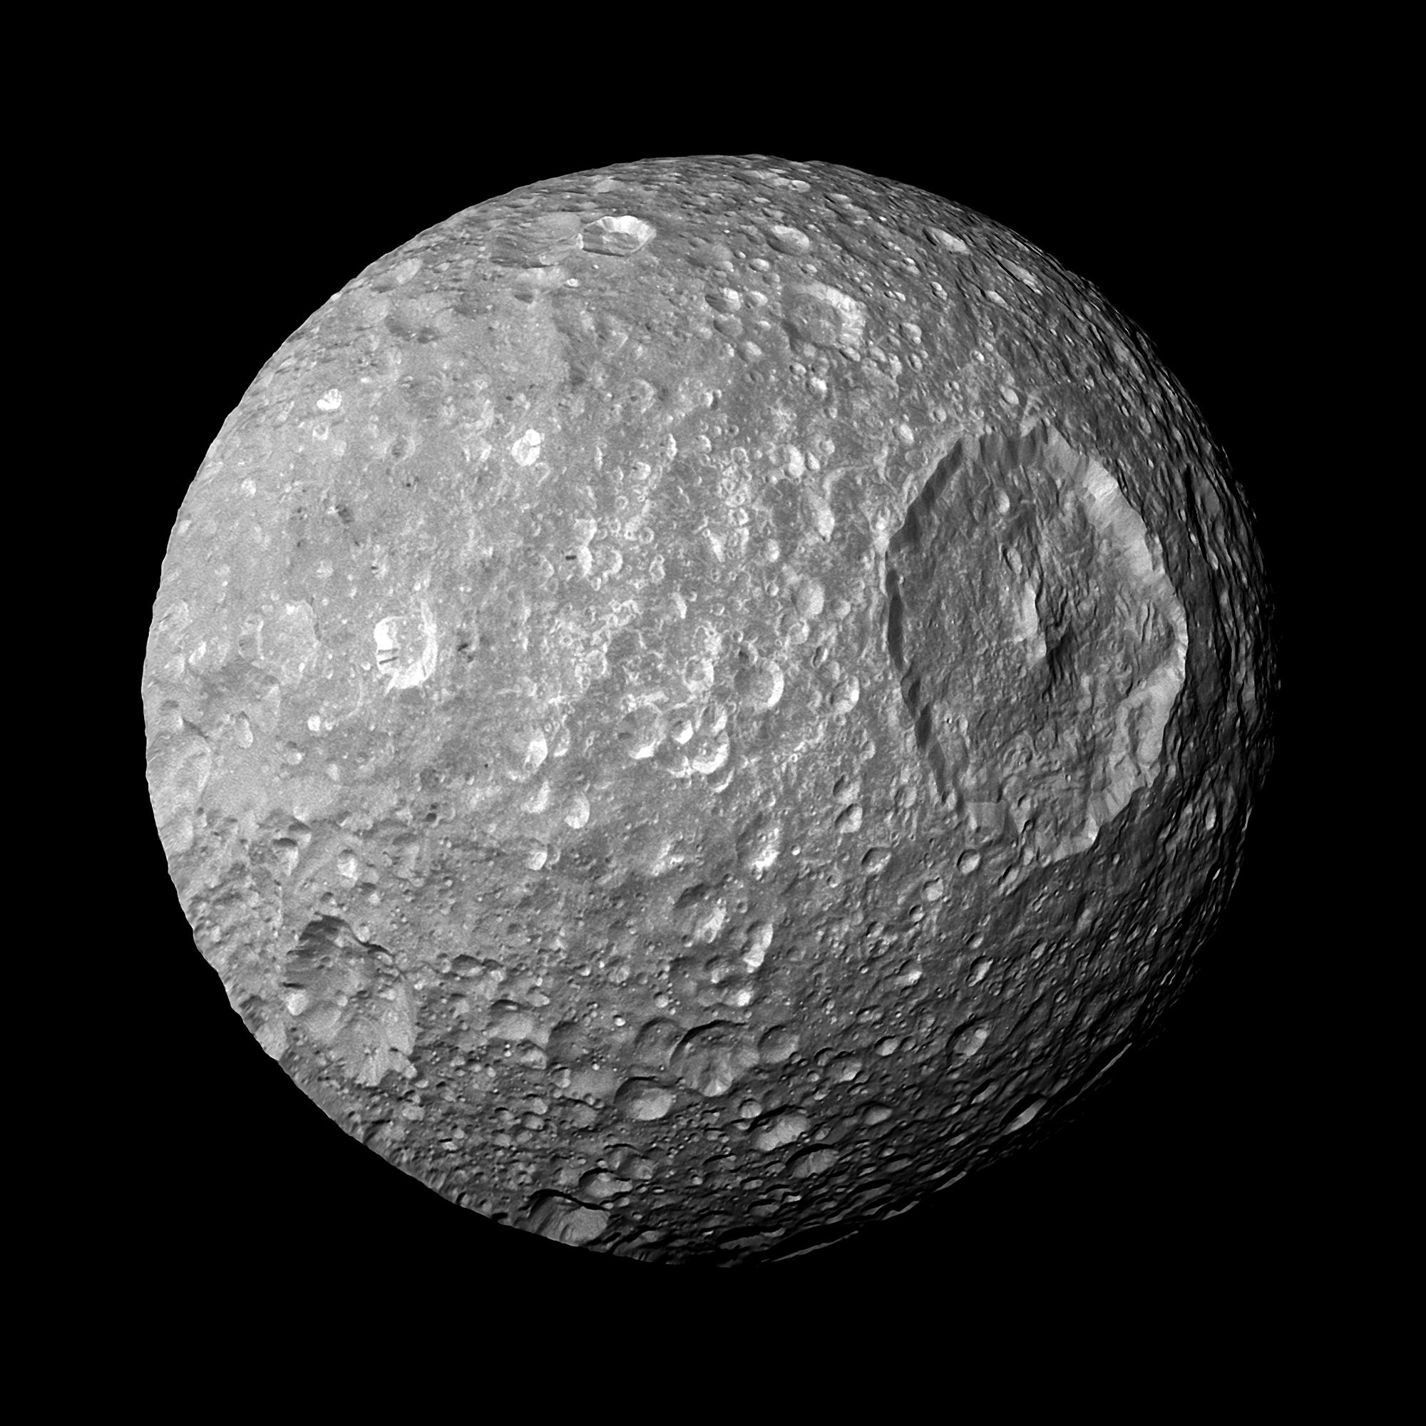
Saturn’s Moons
Pan
Titan
Mimas
Enceladus
Iapetus
JPL/NASA

Slide 22
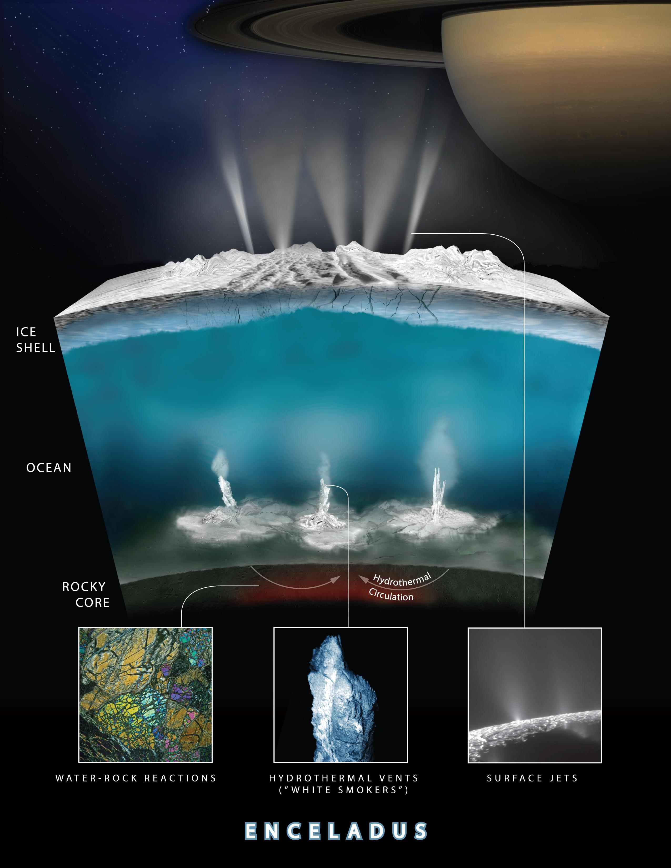
Saturn/ Enceladus
JPL/NASA
Notes:
Life in subsurface ocean

Slide 23
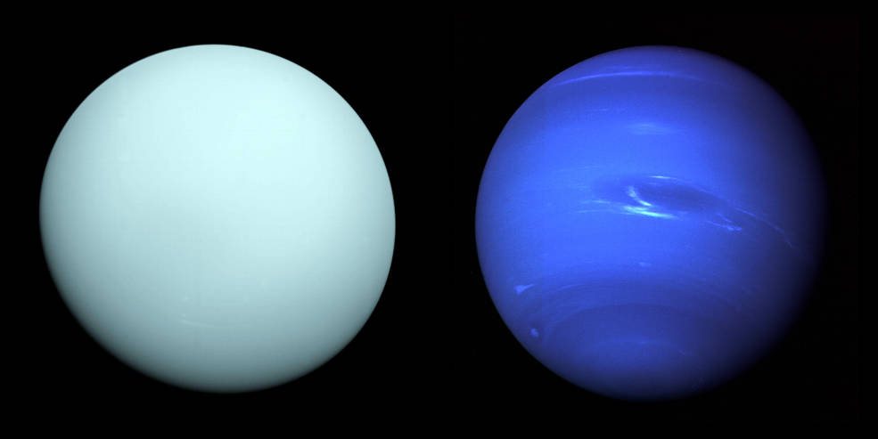
The Ice Giants

Slide 24
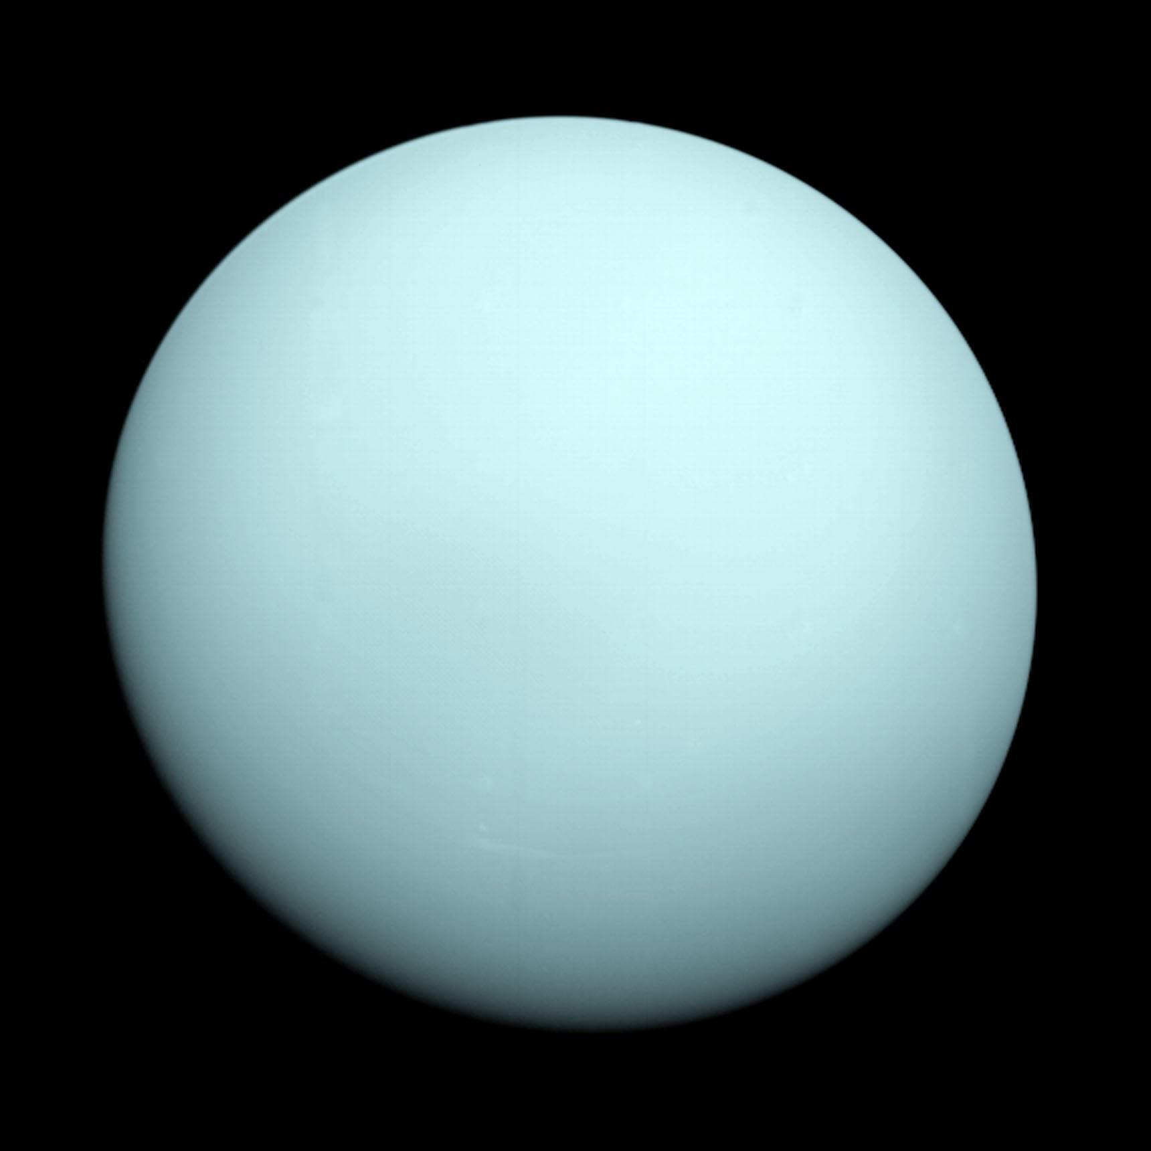
Uranus
JPL/NASA
Notes:
Only visited by voyager 2 – ICE GIANT Ices suggest that water/brine ocean conducts elec and causes mag field Rotates on its side? No idea why cant be impact – moons orbit the same

Slide 25
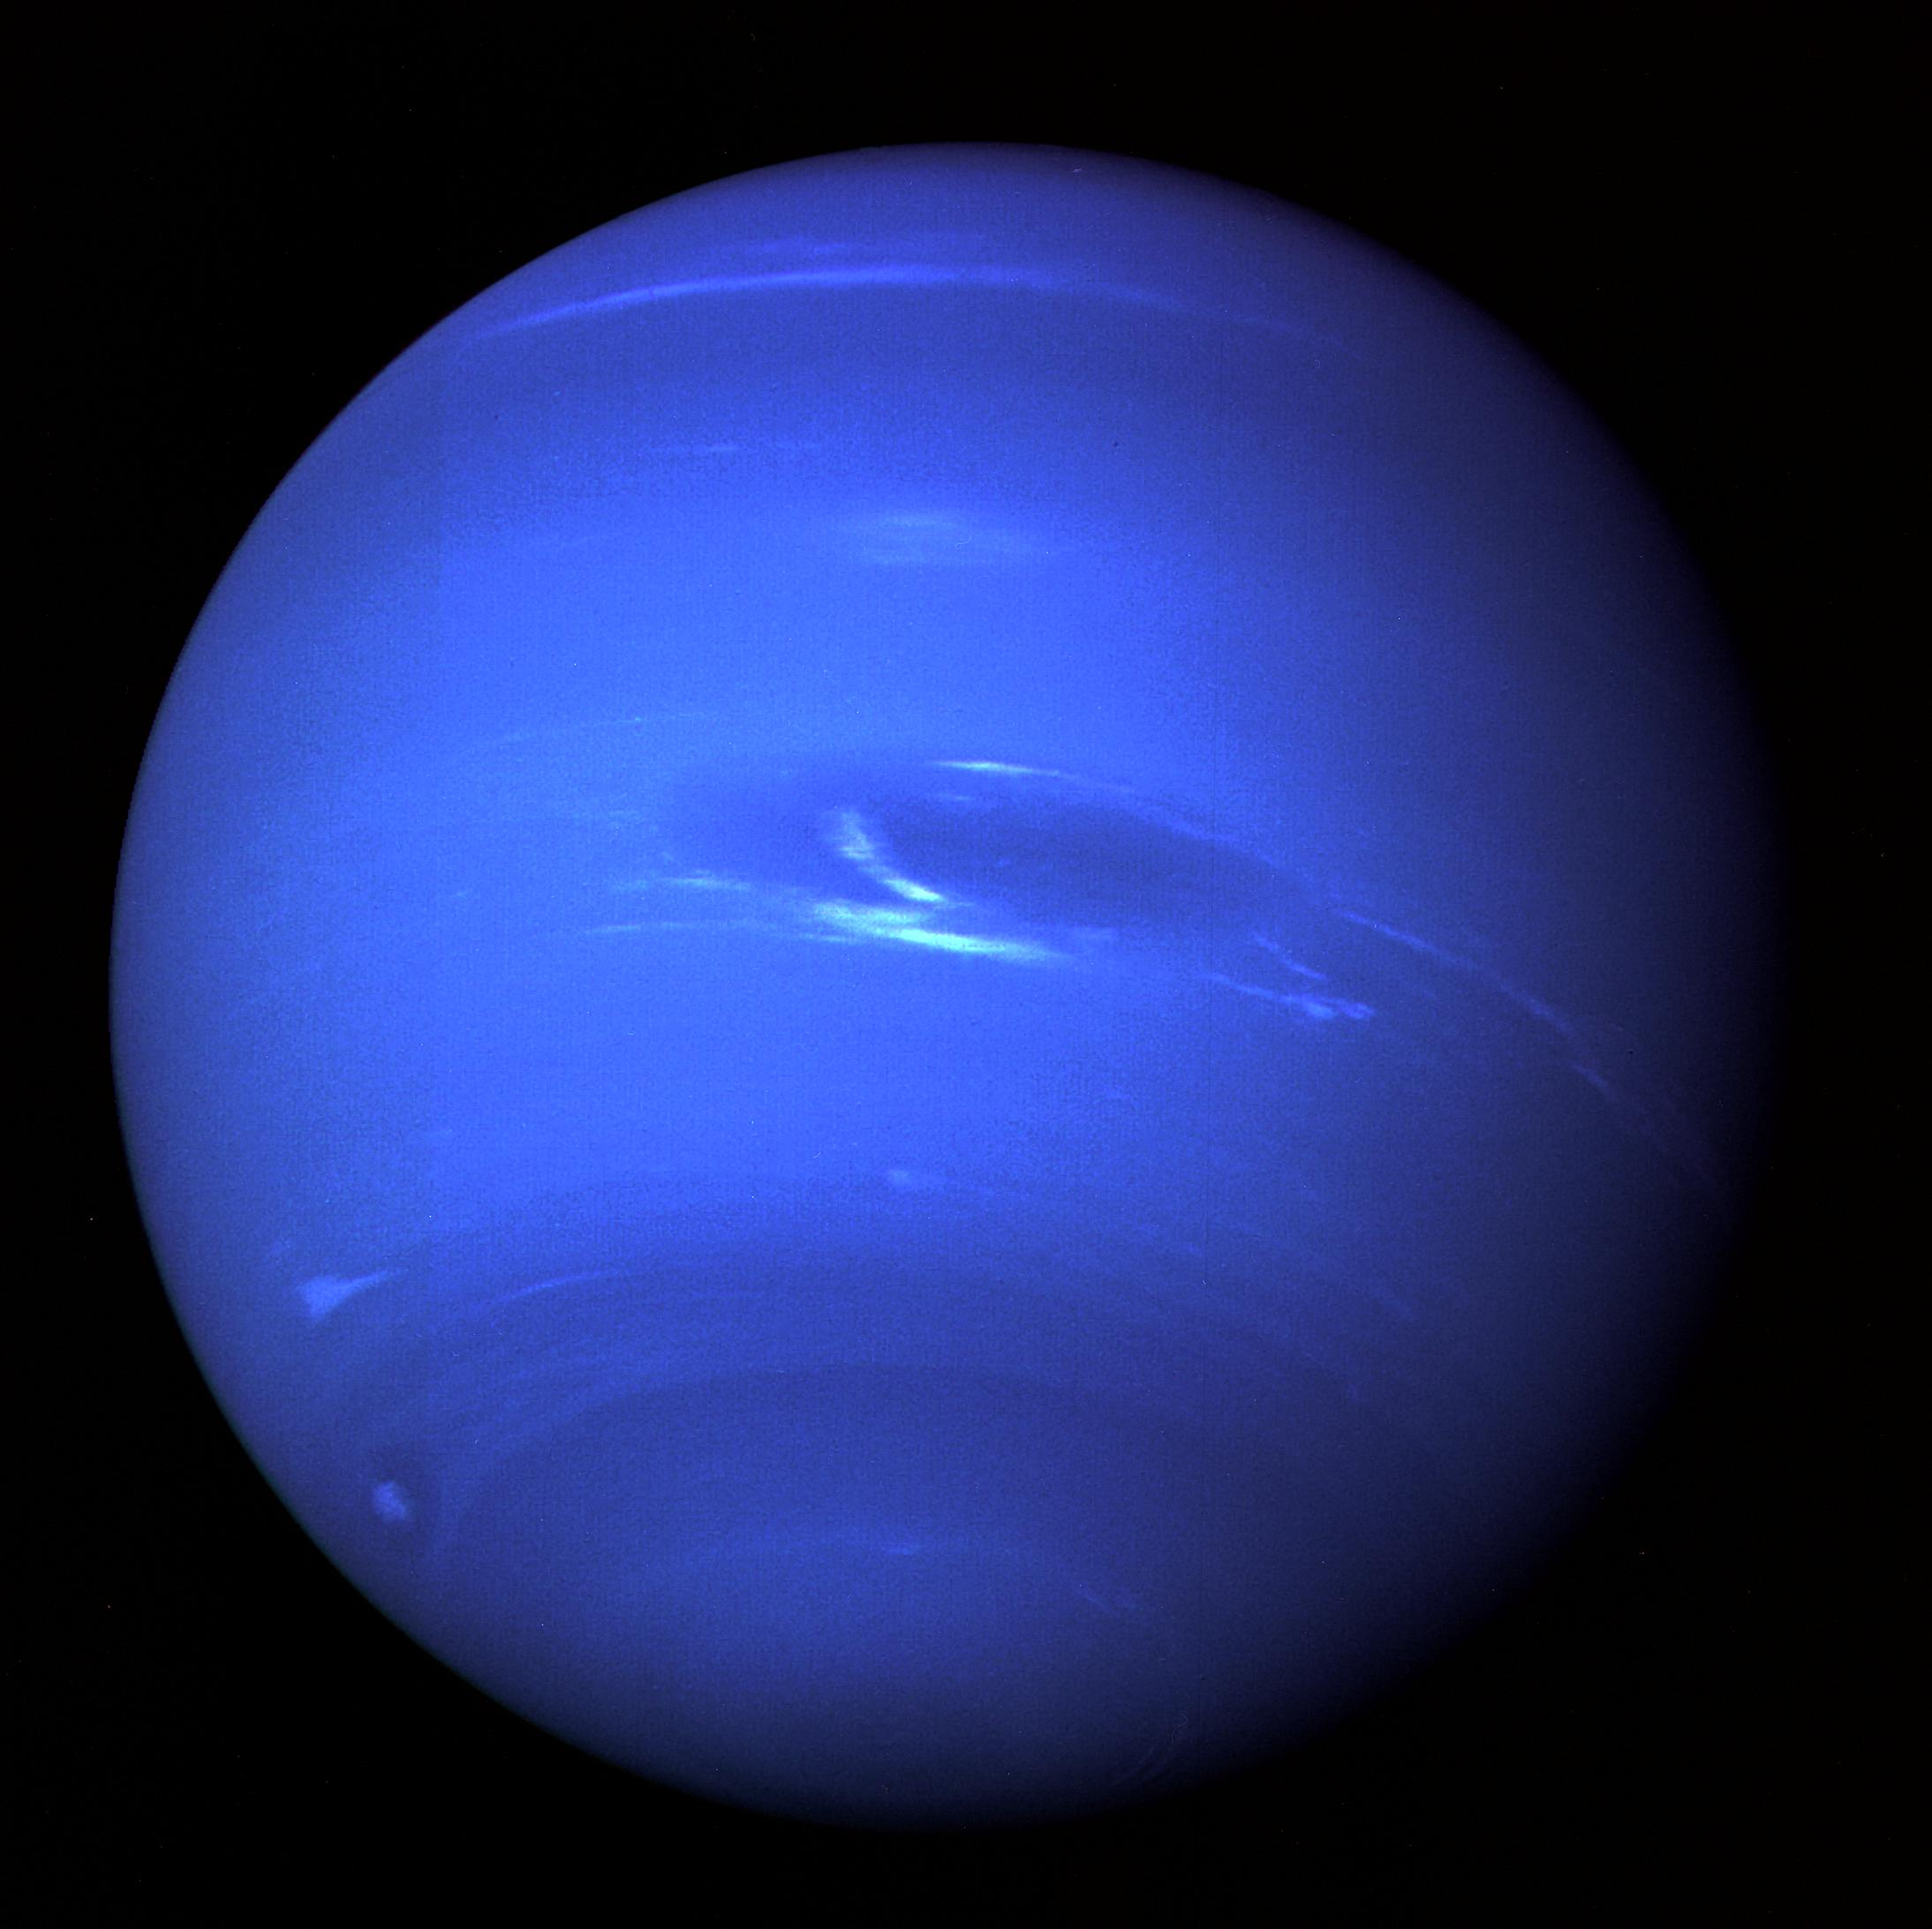
Neptune
JPL/NASA
Notes:
Only visited by voyager 2

Slide 26
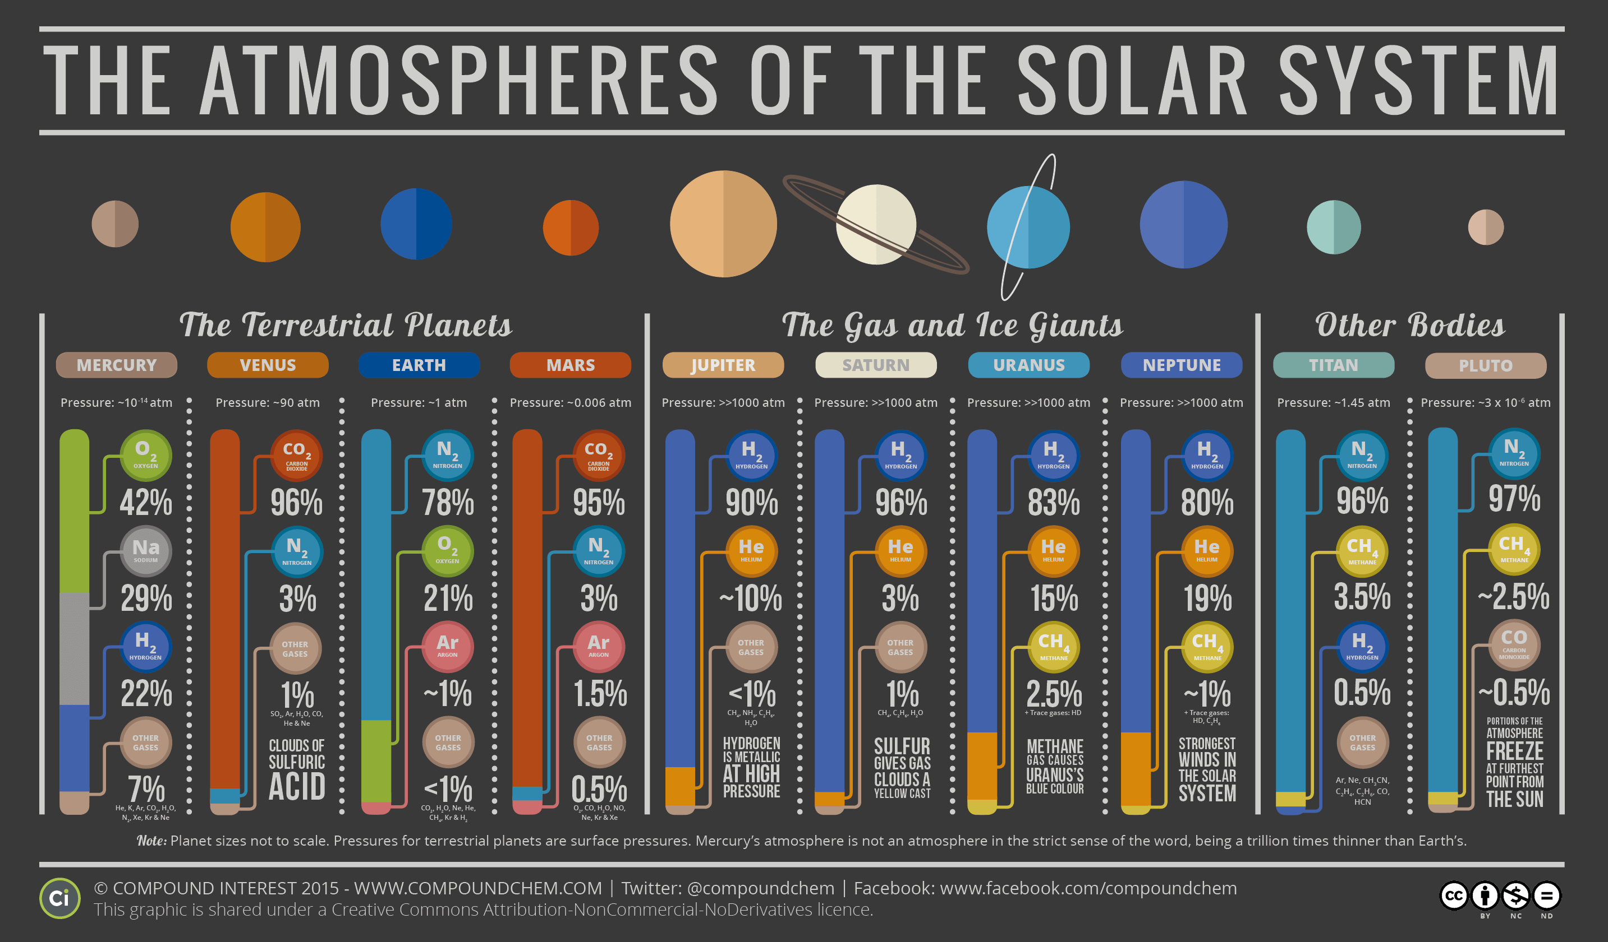

Slide 27
Planetary Surfaces
Up next:

